Slide 1


ITI1121A
LAB #6
Friday 11:30 – 14:30
Professor: Nour El-Kadri
TA: Berk Soysal
bsoys096@uottawa.ca
Office Hour: Fridays 15:00 – 16:00
Office Location: SITE 5000D
Download this ppt. - http://uottawa.ml
2016 Winter Prepared by Berk Soysal for ITI1121A

Slide 2
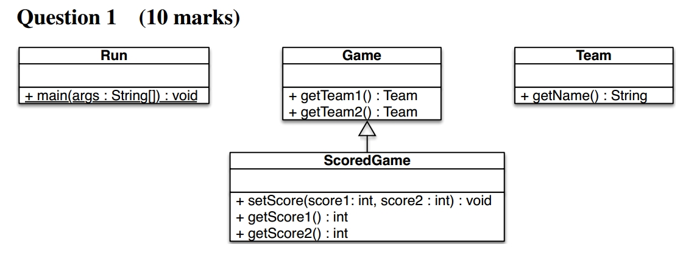
Midterm Solutions
2016 Winter

Slide 3
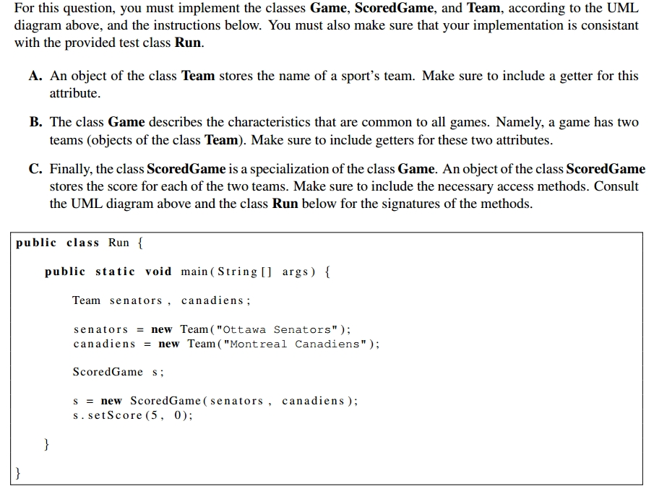
Midterm Solutions
2016 Winter

Slide 4
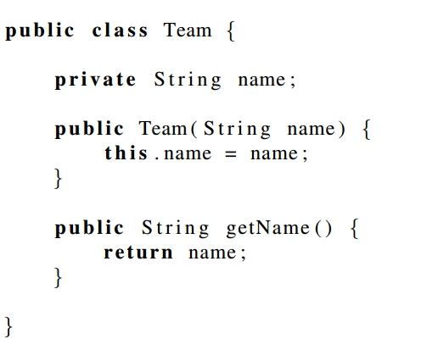
A. Implement the class Team in the box below.
2016 Winter

Slide 5
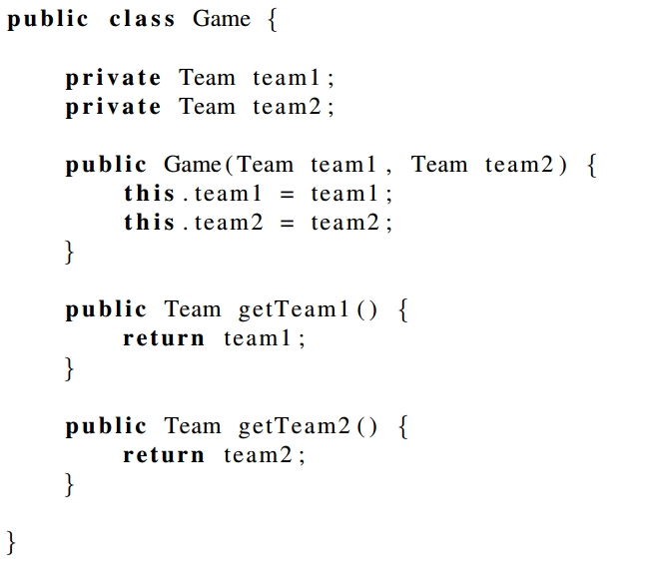
B. Implement the class Game in the box below.
2016 Winter

Slide 6
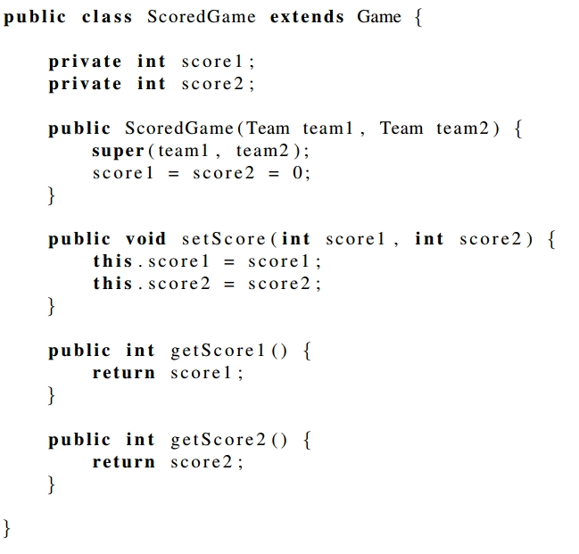
C. Implement the class ScoredGame in the box below.
2016 Winter

Slide 7
Question 2a - Fix 5 errors in the following Java program so that it compiles and runs without error.
int
public class Utils{
public static factorial(n){
result=1;
for(i=1,i<=n;i++){
result=i*result;
}
result;
}
}
int
int
int
return
2016 Winter

Slide 8
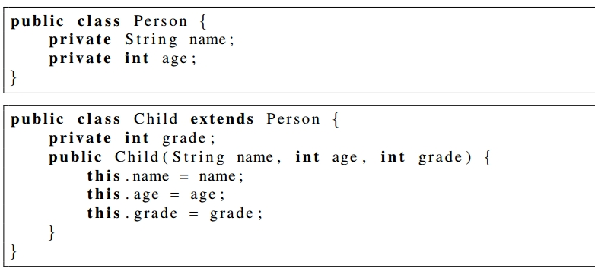
Question 2b - Explain why the following Java code does not compile.
2016 Winter

Slide 9
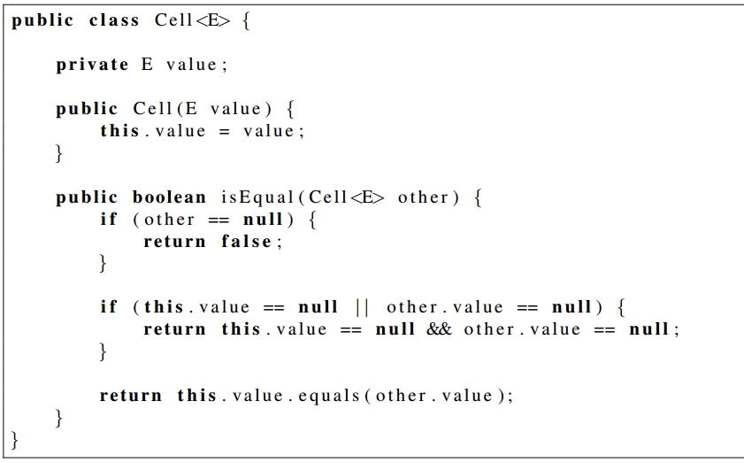
Question 2c - Given the declaration of the class Cell below.
2016 Winter

Slide 10
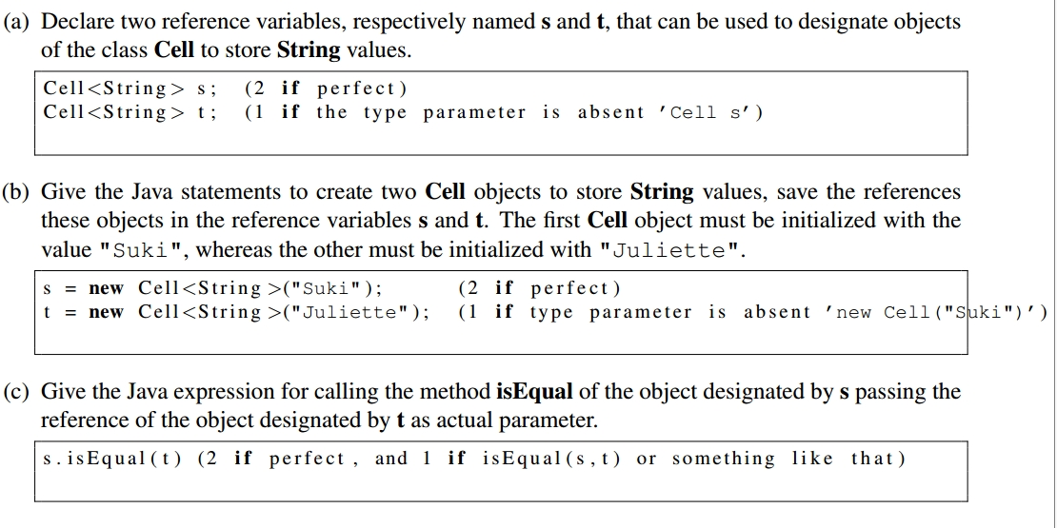
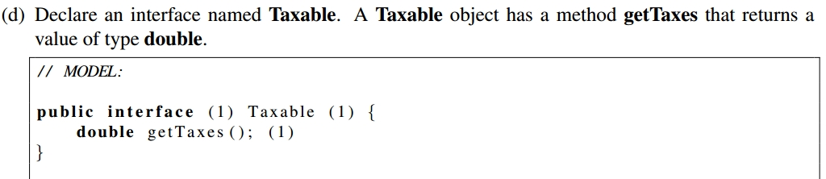
Question 2c - cont’d
2016 Winter

Slide 11
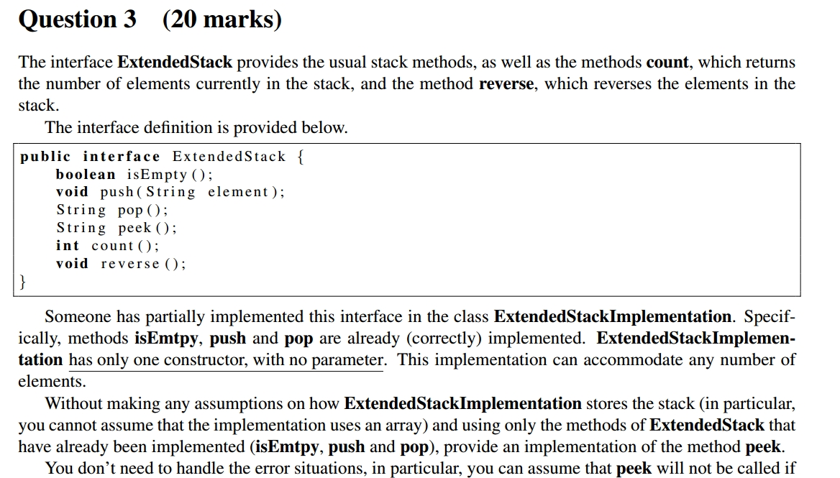
2016 Winter

Slide 12
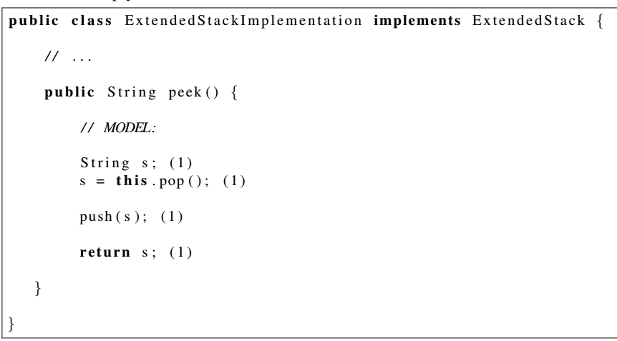
2016 Winter

Slide 13
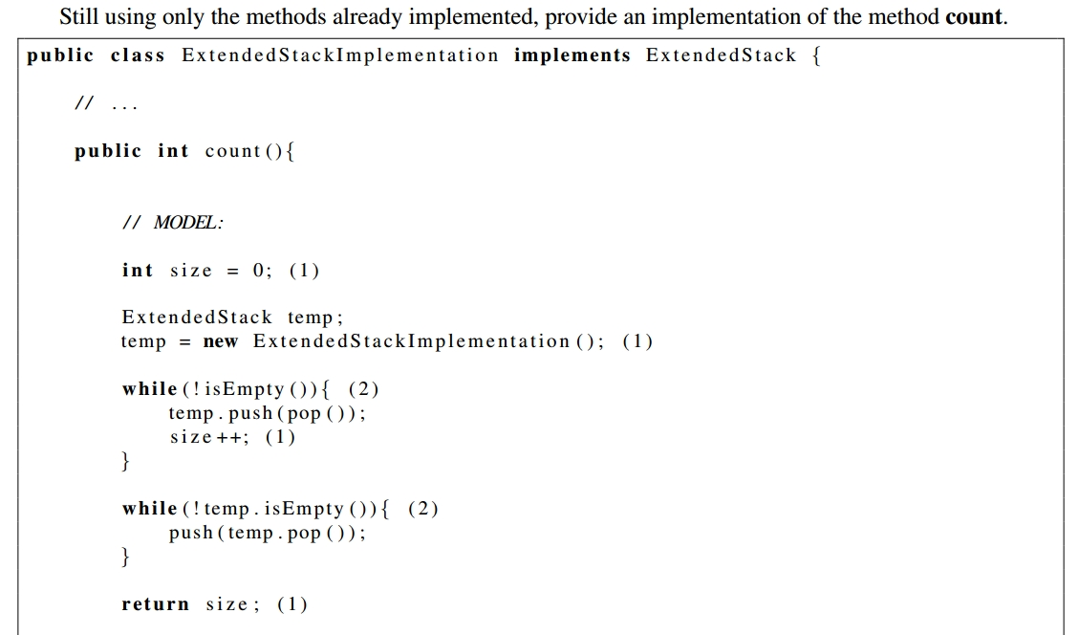
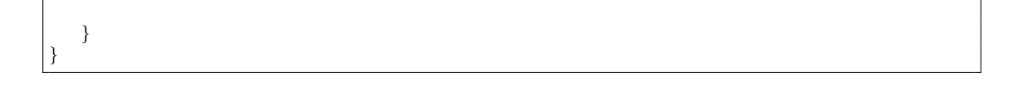
2016 Winter

Slide 14
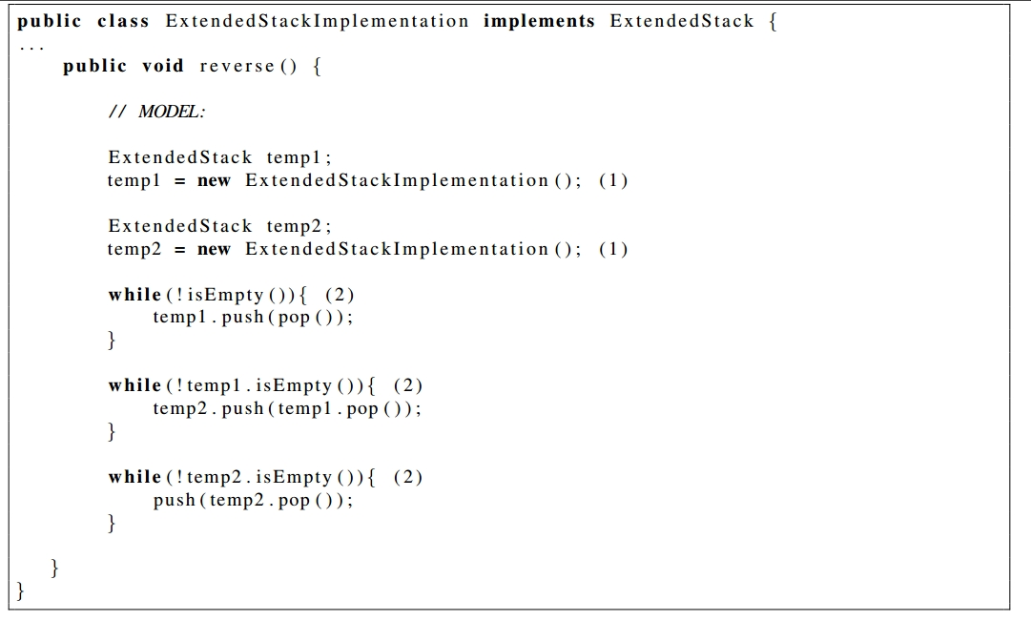
2016 Winter

Slide 15
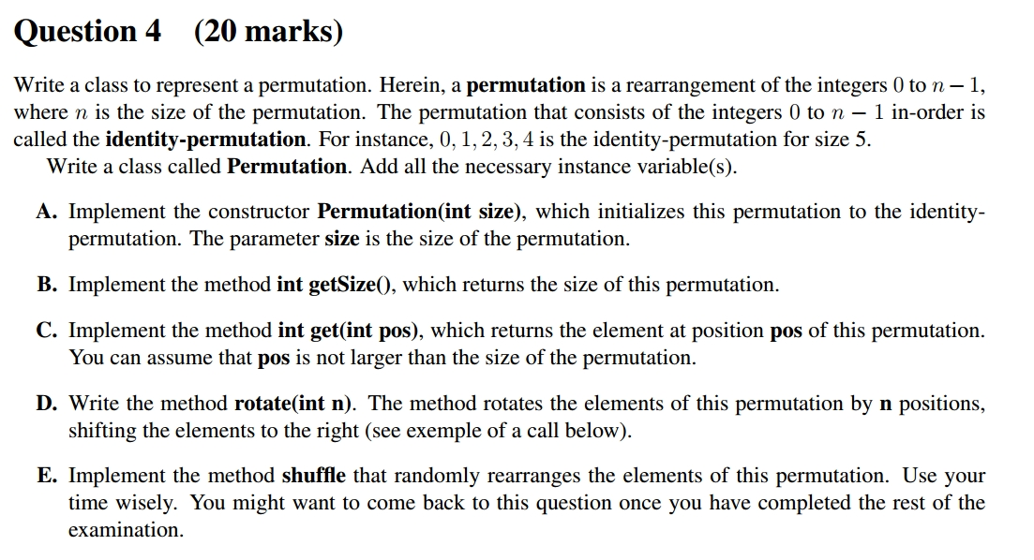
2016 Winter

Slide 16
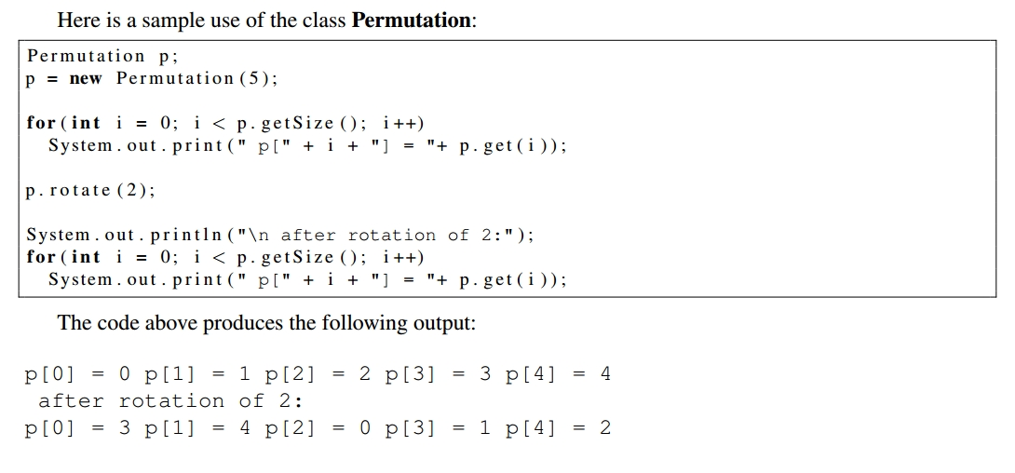
2016 Winter

Slide 17
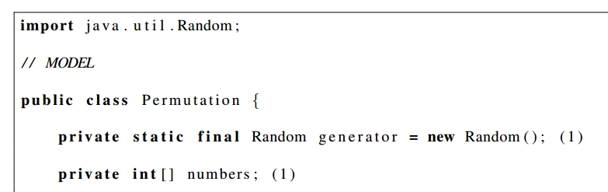
2016 Winter

Slide 18
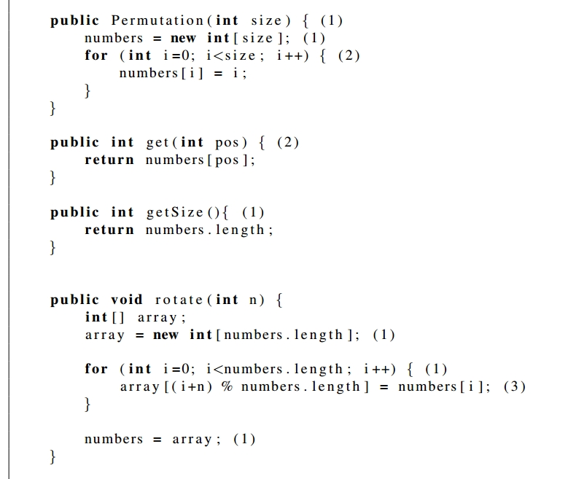
2016 Winter

Slide 19
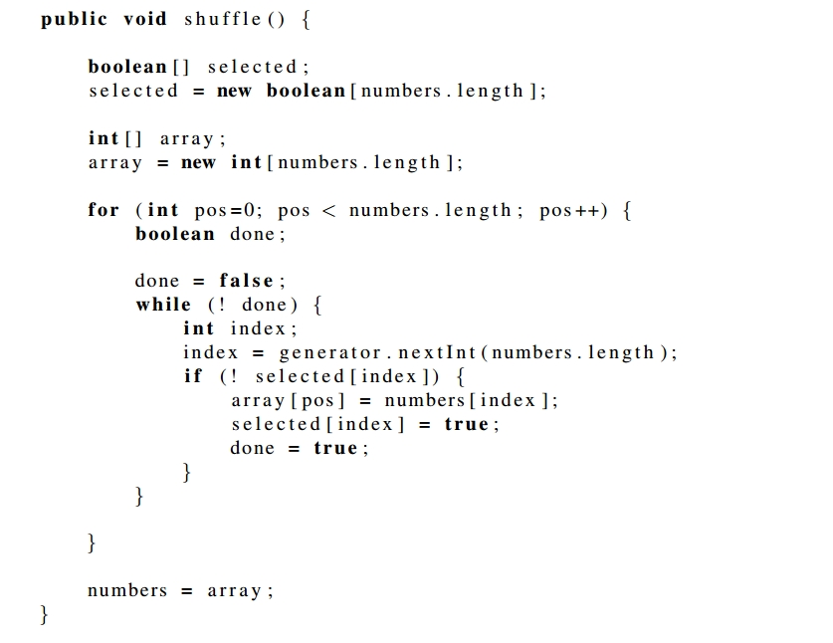
2016 Winter

Slide 20
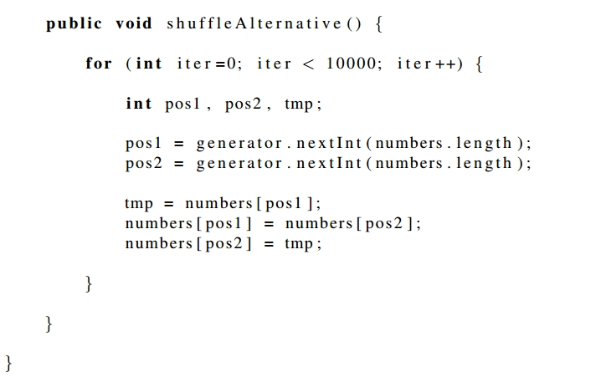
2016 Winter

